Slide 1

KG-MIS
Kerchanshe Group Marketing Intelligence System
USER ACCEPTANCE TESTING (UAT) EDITION · v1.0
“Transforming market data into actionable intelligence.”
A clear, task-based reference for UAT participants to exercise every KG-MIS module during testing.
Prepared by: Kerchanshe Group IT (Solution Development Team)

Slide 2

01 System Overview
KG-MIS helps Kerchanshe Group's Marketing department collect, monitor, analyze, and visualize market and field data for better business decisions.
Area
Purpose
Dashboard
Real-time snapshot of sales, visits, interviews, and alerts
Market Visits
Log and track visits to retail / wholesale outlets
Interviews
Record structured feedback from customers, distributors, retailers, agents
Photos & Videos
Upload and manage field evidence with a validation workflow
Forms & Surveys
Build dynamic forms and collect responses from field or public
Competitor Pricing
Track competitor prices and receive automatic gap alerts
Weekly Sales
Record point-of-sale quantity and revenue data
Officer Performance
Self-service KPI scoring, plan tracking, activity history
Reports & Analytics
AI-generated insights, charts, and data export
Notifications
Stay informed about system events via email alerts
Admin Centre
Manage users, roles, master data, notifications, audit trail
KG-MIS | User Acceptance Testing Guide · v1.0
1

Slide 3




02 Test Accounts & Logging In
URL: /login
ACCESS: All roles
How to Log In
Username
Role
Regions
1. Open your browser and navigate to the KG-MIS URL provided for UAT.
2. Enter your Username and Password.
3. Click Sign in.
admin
Administrator
All
tsegaye.n
Marketing Manager
All
analyst1
Marketing Analyst
All
field1
Field Officer
Addis Ababa, Oromia
field2
Field Officer
Amhara, SNNPR
Result: success lands you on the Dashboard; failure shows a message explaining what went wrong.
viewer1
Executive Viewer
All
Password for every test account: Password123!
Why region matters: A Field Officer only sees data for their assigned region(s). If a record isn't showing for field1/field2, confirm it belongs to their region before flagging a defect.
Sign out via the sidebar, or the top-bar user menu.
Production uses CUAS SSO; UAT uses local username/password instead.
KG-MIS | User Acceptance Testing Guide · v1.0
2

Slide 4


03 Navigating KG-MIS
Sidebar sections and what's visible to each role.
Section
Item
Visible to
Overview
Dashboard, Notifications
All five roles
Field Intelligence
Market Visits
Admin, Manager, Analyst, Field Officer
Field Intelligence
Interviews / Photos & Videos / Forms & Surveys
All five roles
Field Intelligence
Competitor Pricing
Admin, Manager, Analyst, Field Officer
Field Intelligence
Weekly Sales
All five roles
Field Intelligence
My Performance
Admin, Manager, Analyst, Field Officer
Analytics
Reports & Power BI
Admin, Manager, Analyst, Viewer
Administration
Admin Centre, Planning, Business Groups, Customers, Products, Regions
Administrator only
On Every Page
✓ Notification bell with unread badge, dark-mode toggle, and user menu in the top bar.
✓ Toast confirmations appear top-right and clear automatically.
✓ A red banner appears if a section fails to load; an access-denied message appears for pages your role can't open.
KG-MIS | User Acceptance Testing Guide · v1.0
3

Slide 5


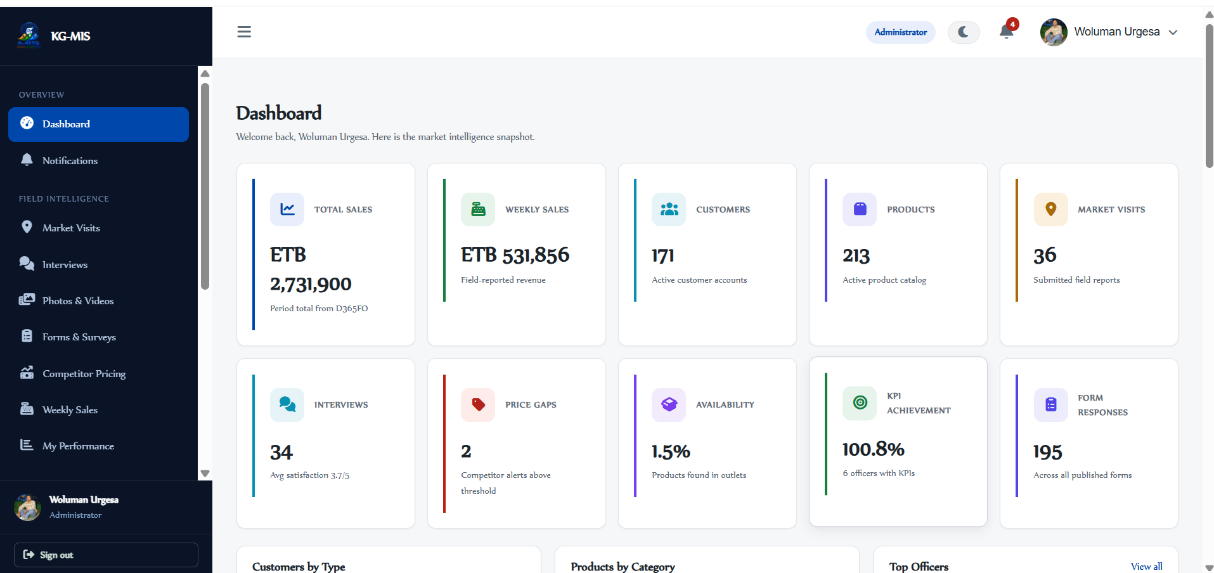
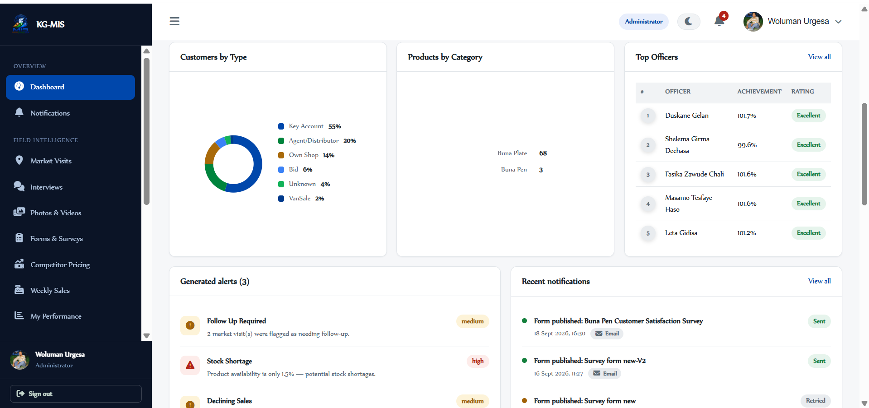
04 Dashboard
URL: /dashboard
ACCESS: All roles
Your home screen — a high-level view of all marketing intelligence data.
Test Steps
What to Verify
1. Log in and land on the Dashboard.
2. Review the 10 KPI cards, charts, Generated Alerts, and Recent Notifications.
3. Read the AI Insights panel (rule-based observations, not machine learning).
4. Click each of the 10 Quick Capture tiles.
✓ All 10 KPI cards load: Sales, Weekly Sales, Customers, Products, Visits, Interviews, Price Gaps, Availability, KPI Achievement, Form Responses.
✓ Charts render: Customers by Type, Products by Category, Top Officers.
✓ Alerts are ranked High / Medium / Low; each Quick Capture tile opens the right module.
KG-MIS | User Acceptance Testing Guide · v1.0
4

Slide 6

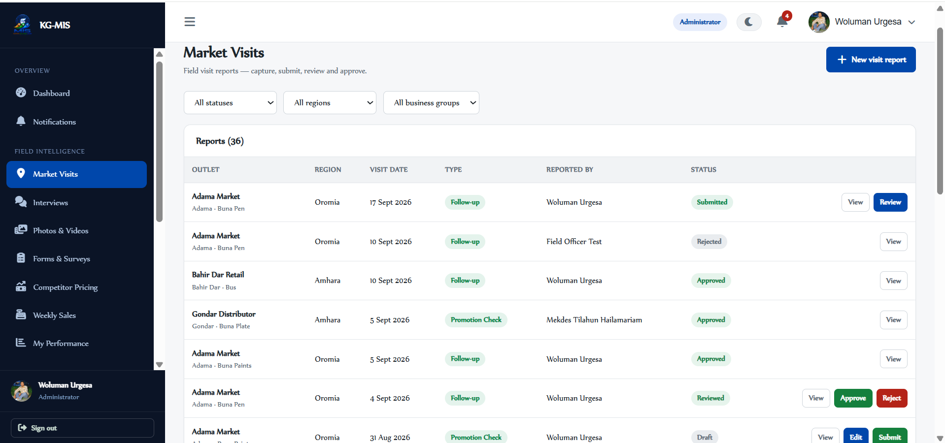
05 Market Visits
URL: /visits
ACCESS: Admin, Manager, Analyst, Field Officer
Record and track visits to retail/wholesale outlets — stock levels, competitor presence, and findings.
Test Steps
What to Verify
1. Click New visit report; complete Outlet, Visit date, Visit type.
2. Optionally add stock level, competitor presence, findings, notes.
3. Save, then Submit — this emails the Marketing Manager.
4. As Manager/Admin: Review, then Approve or Reject (reason required); the author is emailed either way.
5. Filter by outlet, region, status, date range, business group.
✓ Lifecycle flows Draft → Submitted → Reviewed → Approved/Rejected.
✓ Field Officers can create/edit only their own reports, while Draft.
✓ Field Officers see only their own visits; Managers/Admins see all; Analysts see all read-only.
KG-MIS | User Acceptance Testing Guide · v1.0
5

Slide 7

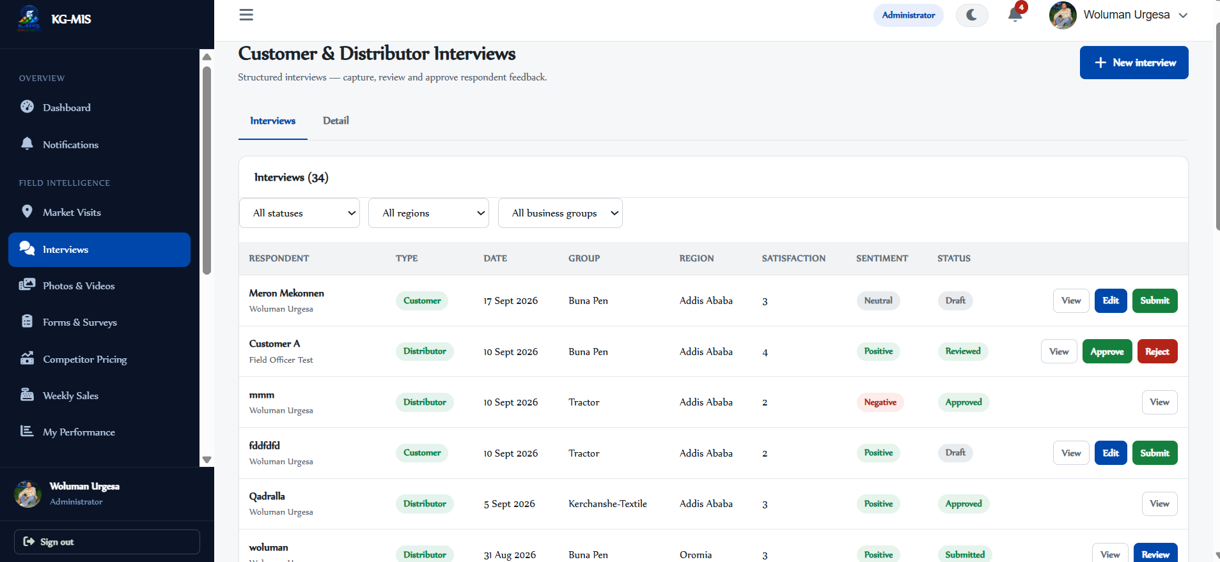
06 Interviews
URL: /interviews
ACCESS: All roles (Viewer: read-only)
Capture structured interviews with customers, distributors, retailers, and agents.
Test Steps
What to Verify
1. Click New interview; complete Respondent name/type, Interview date, Region.
2. Optionally add satisfaction score (1–5), Q&A pairs, feedback, photo/video.
3. Save, then Submit → Review → Approve/Reject (same flow as Market Visits).
4. Open a record's Detail view and check the sentiment badge.
✓ Sentiment auto-sets from score: 1–2 Negative, 3 Neutral, 4–5 Positive.
✓ GPS location is captured automatically if the browser allows it.
✓ Viewer role can view but not create/edit records.
KG-MIS | User Acceptance Testing Guide · v1.0
6

Slide 8

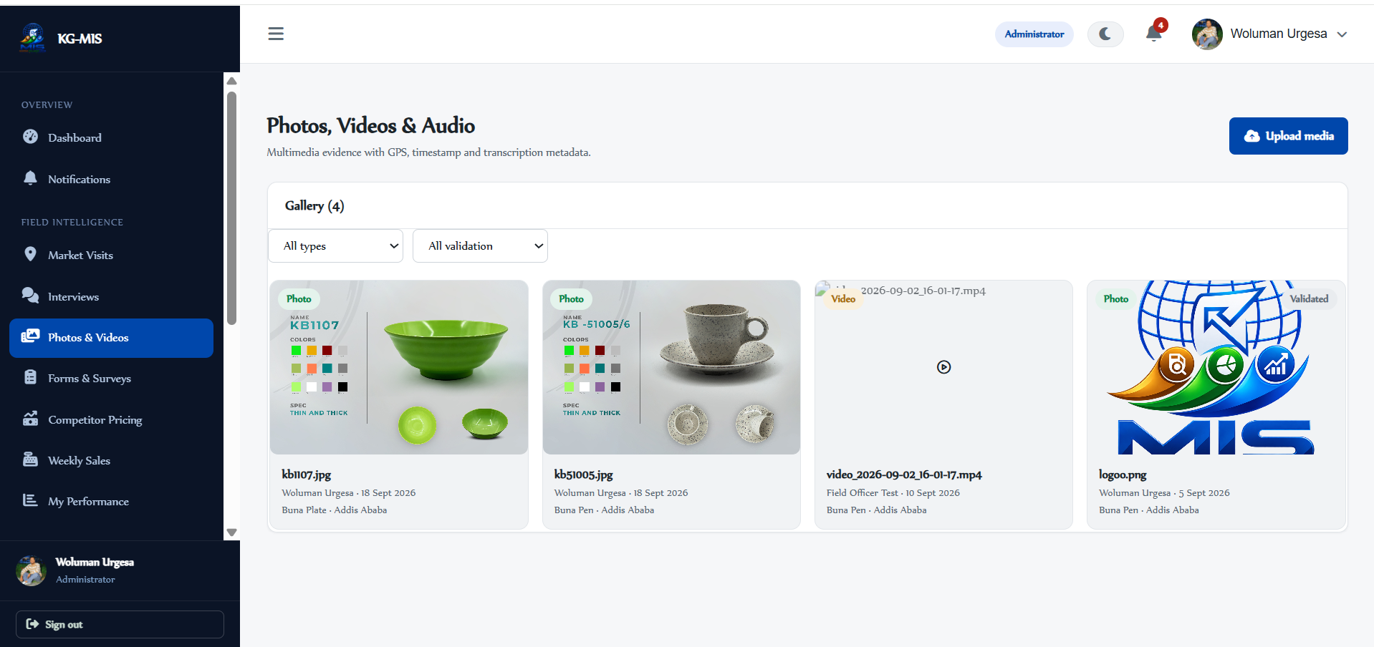
07 Photos & Videos
URL: /multimedia
ACCESS: All roles (Validate: Admin, Manager)
Upload, view, and manage field photos, videos, and audio recordings.
Test Steps
What to Verify
1. Click Upload; choose a file — media type is detected automatically.
2. Set Capture date; optionally link to a Market Visit/Interview, tag Region/Outlet/Notes.
3. Save, then as Admin/Manager test Validate and Reject.
4. Add a transcription for video/audio; as uploader, test Delete.
✓ Tiles show a type badge (Photo/Video/Audio) and validation status.
✓ Only Admin/Manager can validate or reject.
✓ Only the uploader can delete their own item.
KG-MIS | User Acceptance Testing Guide · v1.0
7

Slide 9

08 Forms & Surveys
URL: /forms
ACCESS: Build: Admin/Mgr/Analyst · Respond: all roles
The largest module — build dynamic multi-page forms, publish them, collect responses, and analyze results.
8.1 For Form Builders
8.2 For Respondents
1. New form → enter Title/Description.
2. Add fields from the palette — 30+ field types (text, choice, media, location, logic).
3. Add logic: branching, display conditions, calculated fields, scoring.
4. Settings: access mode, response limits, GDPR consent, branding.
5. Save = draft version. Publish = goes live (separate step).
1. Under Open forms, find the target form and click Fill in.
2. Complete required fields (and consent, if required).
3. Optionally Save as draft — resume link valid 7 days.
4. Click Submit.
✓ Confirmation screen / branded thank-you appears.
✓ Responses tab, anomaly flags, and Report tab (export to Excel/PDF) work for reviewers.
Draft
Published
Archived
Autosaves every few seconds — Publish is a separate, deliberate step.
KG-MIS | User Acceptance Testing Guide · v1.0
8

Slide 10
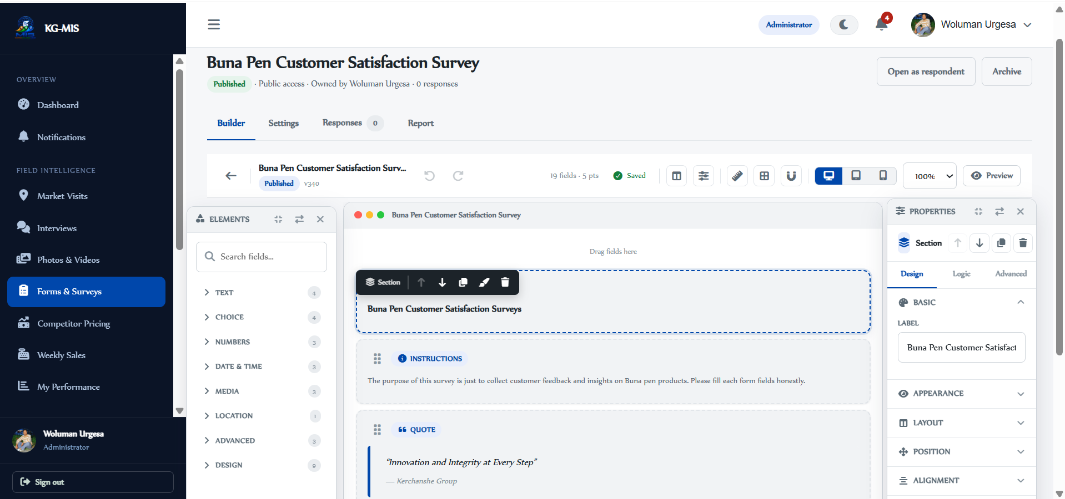
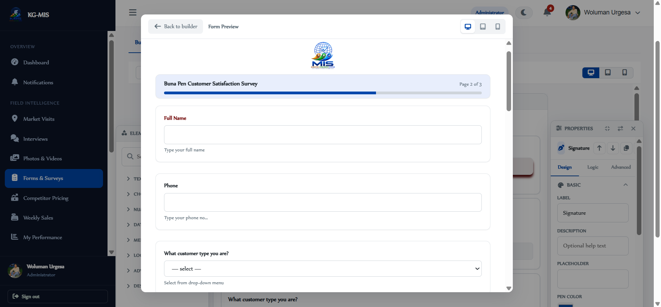
8.1 For Form Builders
8.2 For Respondents

Slide 11

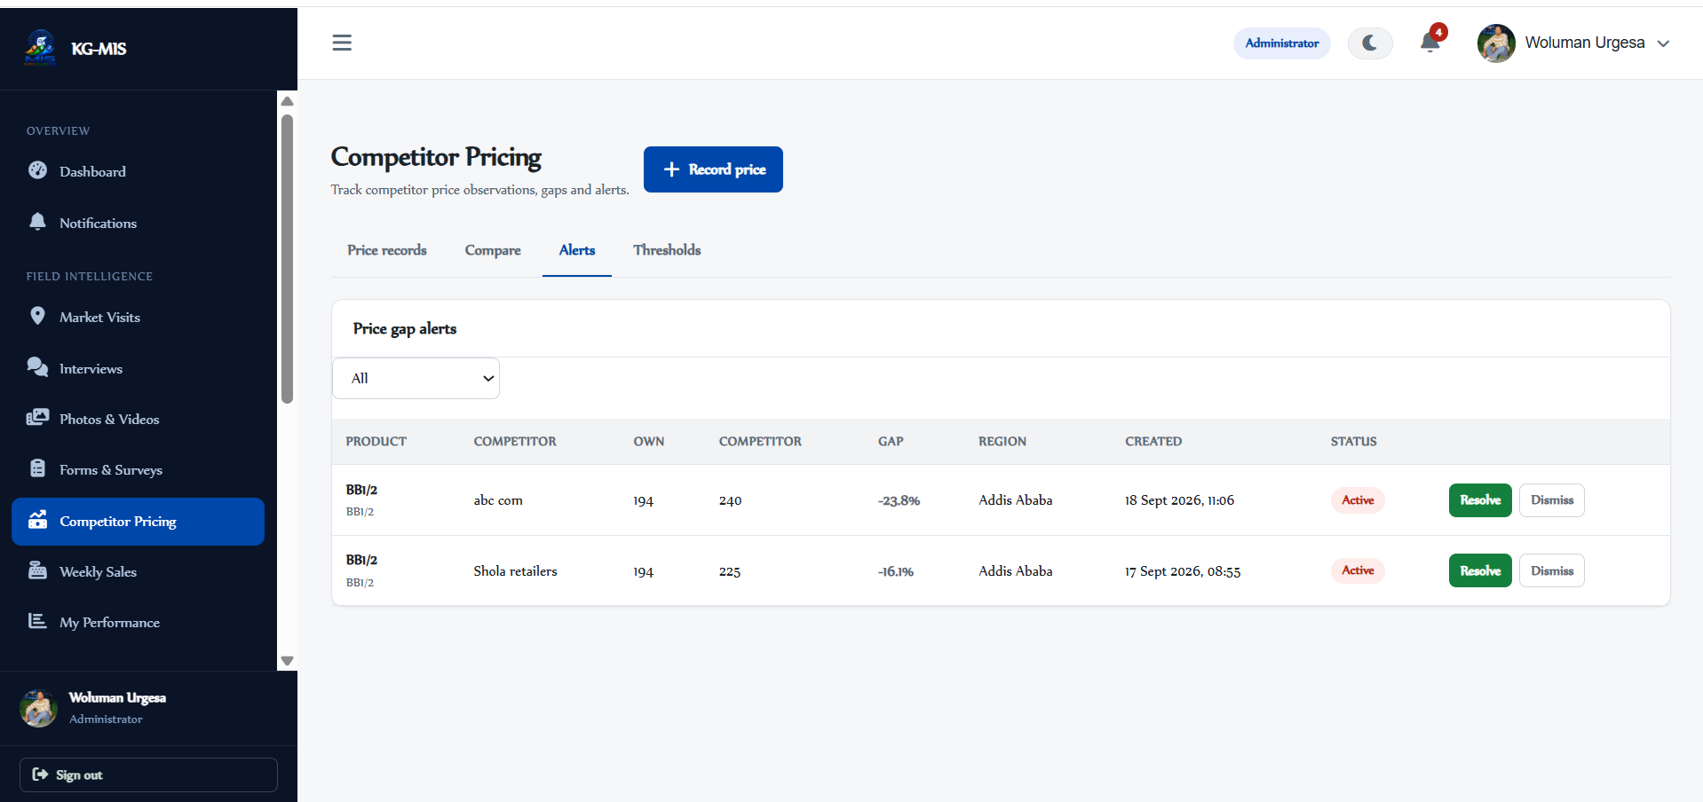
09 Competitor Pricing
URL: /pricing
ACCESS: Admin, Manager, Analyst, Field Officer
Record competitor prices, compare to Kerchanshe's own, and get alerts when the gap is significant.
Test Steps
What to Verify
1. On Price records, click Record price; complete Product, Competitor, Price, Region.
2. Save; open Compare to view Kerchanshe's price vs. every competitor entry.
3. Open Alerts; Resolve or Dismiss a generated alert.
4. (Admin) Open Thresholds and review per-category gap %.
✓ Default thresholds: Buna Pen 20%,Buna Plate 15%, Buna Paints 12%, Coffee 15% — meeting/exceeding one auto-creates an Active alert and emails Manager + Analyst.
✓ Field Officers see/record pricing only for assigned regions; Managers/Admins see all; Analysts have read access to all.
KG-MIS | User Acceptance Testing Guide · v1.0
9

Slide 12

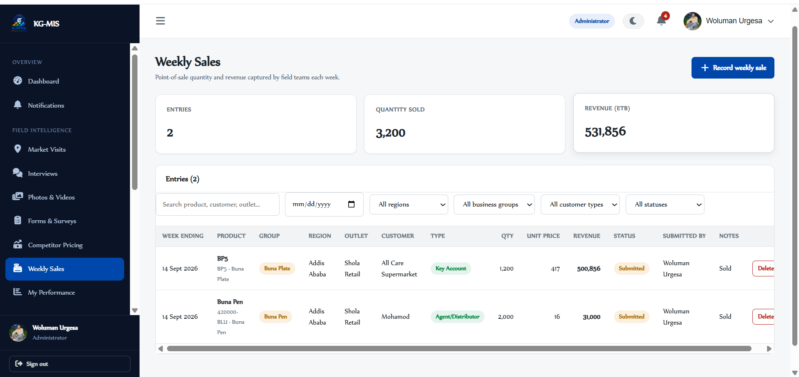
10 Weekly Sales
URL: /weekly-sales
ACCESS: All roles (Viewer: read-only)
Record weekly point-of-sale data — quantity sold and revenue — per product and outlet.
Test Steps
What to Verify
1. Click Record weekly sale.
2. Complete Week ending (a Sunday), Business group, Customer, Product, Region, Outlet, Quantity sold.
3. Confirm Unit price auto-fills once Product + Customer are chosen (editable).
4. Optionally add Notes; Save.
✓ Revenue = Quantity sold × Unit price, calculated automatically.
✓ Only one entry allowed per week / product / outlet combination.
✓ Summary stats (Entries, Quantity sold, Revenue) update after saving.
KG-MIS | User Acceptance Testing Guide · v1.0
10

Slide 13

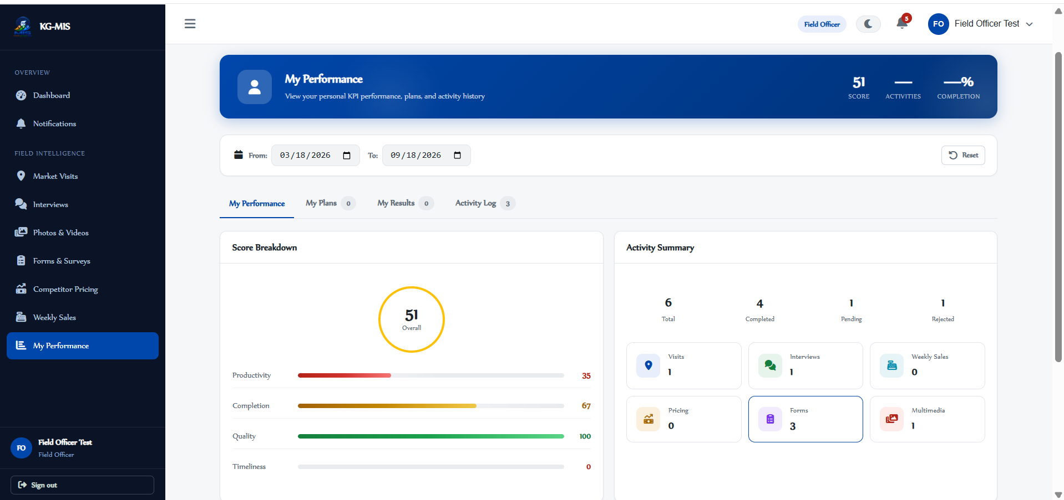
11 Officer Performance
URL: /officer/performance
ACCESS: Admin, Manager, Analyst, Field Officer
A self-service performance dashboard — each user sees their own activity and scoring.
Test Steps
What to Verify
1. Open My Performance and review the overall score ring.
2. Check the Productivity / Completion / Quality / Timeliness breakdown and monthly trend chart.
3. Open My Plans — assigned plans with frequency, status, progress bar.
4. Open My Results (KPI target/actual/score) and Activity Log; try the date range filter.
✓ Each tab shows accurate, user-specific data (no cross-user leakage).
✓ Date range filter narrows results on every tab.
KG-MIS | User Acceptance Testing Guide · v1.0
11

Slide 14

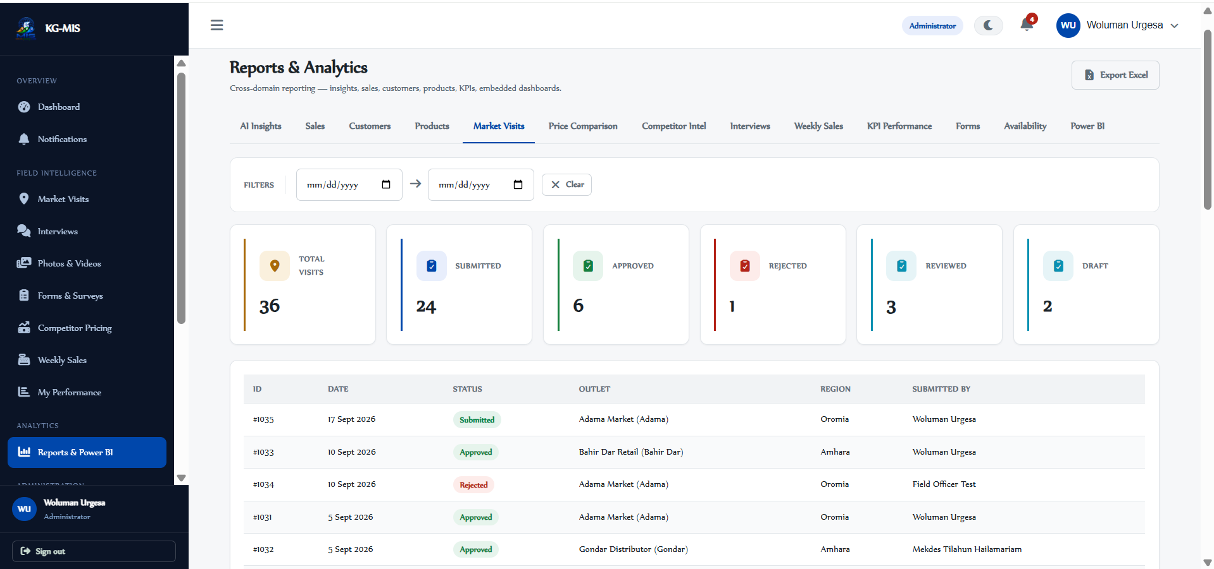
12 Reports & Analytics
URL: /reports
ACCESS: Admin, Manager, Analyst, Viewer
Thirteen report tabs covering every part of the system, plus data export.
Test Steps
What to Verify
1. Open a sample of tabs: AI Insights, Sales, Customers, Products, Market Visits, Price Comparison, Interviews, Weekly Sales, KPI Performance, Forms, Availability, Power BI.
2. Apply date range, region, and business group filters where offered.
3. Click Export and download one of 8 data types (visits, interviews, multimedia, sales, competitor intel, customers, products, KPI results).
✓ Each tab loads its expected charts/tables and updates with filters.
✓ Exported Excel file matches the applied filters.
Power BI in UAT: the dashboard catalogue and role assignment are real, but opening a dashboard shows a placeholder rather than a live embed. This is expected, not a defect.
KG-MIS | User Acceptance Testing Guide · v1.0
12

Slide 15

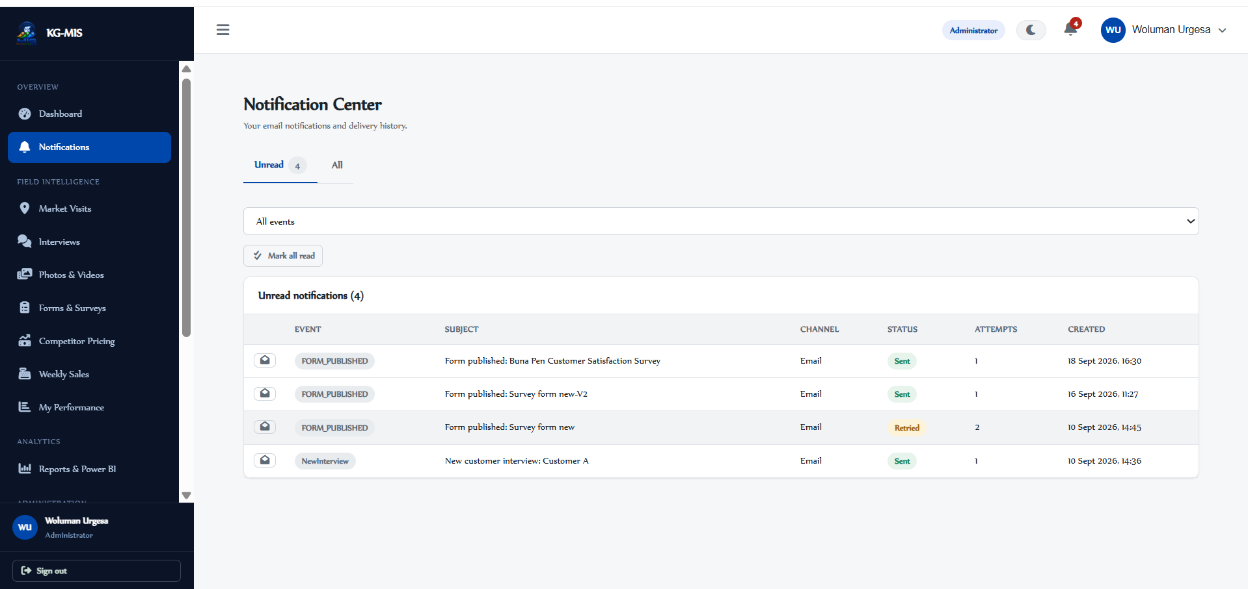
13 Notifications
URL: /notifications
ACCESS: All roles
Your personal notification history and delivery status.
Test Steps
What to Verify
1. Check the Unread and All tabs.
2. Mark a single notification as read; then click Mark all read.
3. Use the Event filter — 30+ event types across visits, interviews, forms, pricing, admin.
✓ Unread count badge updates as items are read.
✓ Delivery status shows: Sent (green), Failed (red), Retried (neutral).
Only Email is dispatched in this build (SMS/WhatsApp/Push/In-App are options but not sent). In UAT, email delivery itself is simulated.
KG-MIS | User Acceptance Testing Guide · v1.0
13

Slide 16

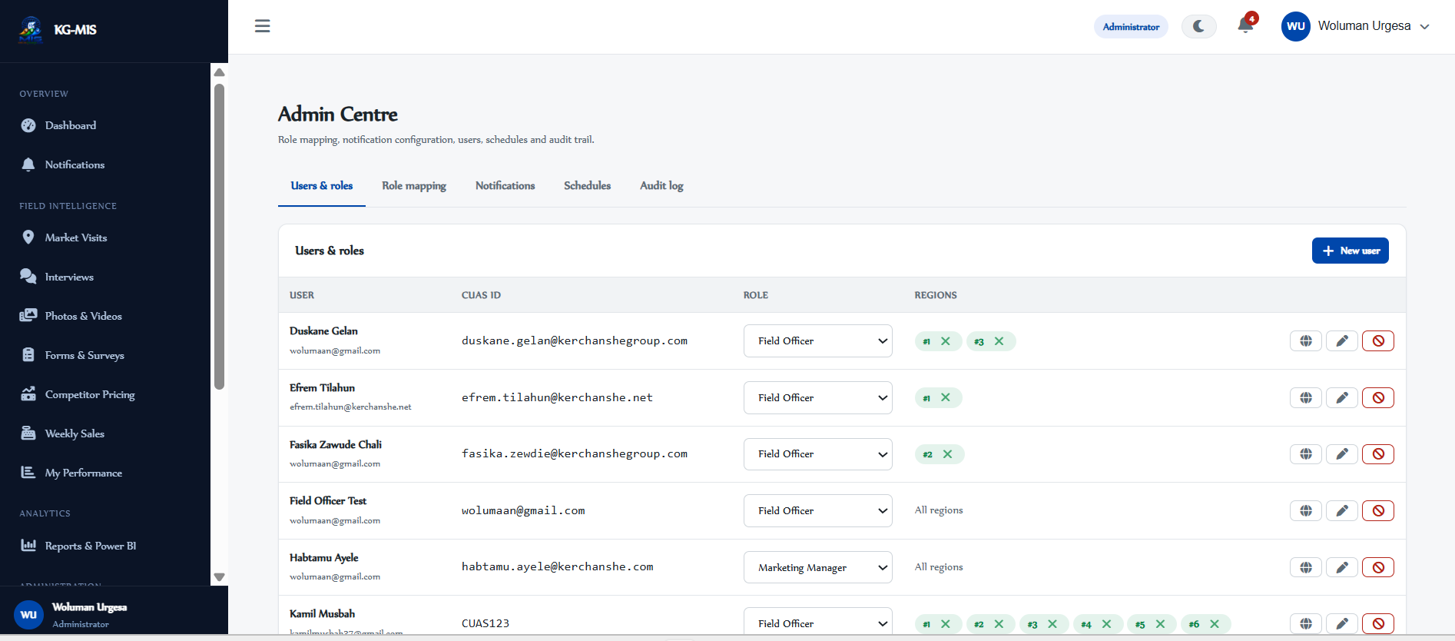
14.1 Admin Centre — Core Administration
URL: /admin
ACCESS: Administrator only
Five tabs for managing users, roles, notifications, and scheduling.
Tab
What you can do
Users & Roles
List users; create/edit; change role inline; activate/deactivate; assign/remove regions
Role Mapping
Map CUAS SSO claims to internal roles
Notifications
Add or remove rules pairing a trigger event, channel, and role
Schedules
Configure Power BI report delivery schedules (cron format)
Audit Log
Search the full audit trail; export to Excel, CSV, or PDF
Partially implemented: report schedules are saved and listed, but nothing currently executes them automatically in this build.
KG-MIS | User Acceptance Testing Guide · v1.0
14

Slide 17
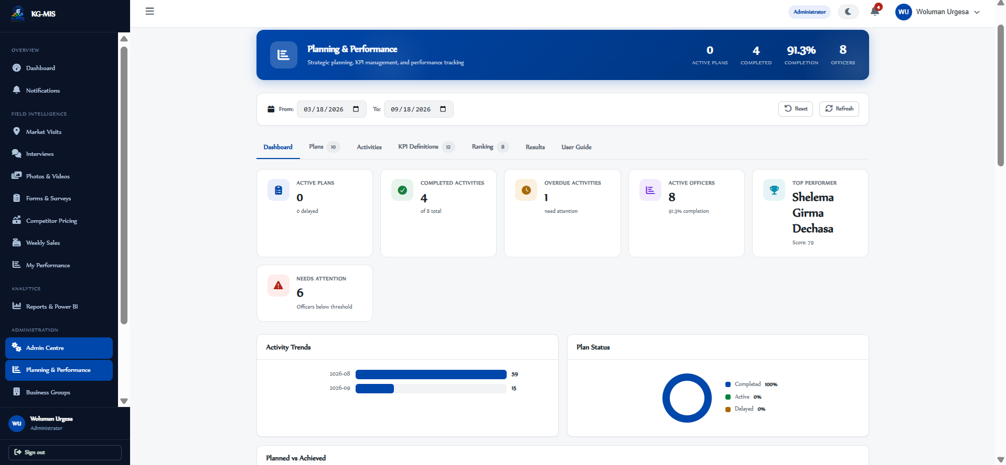
14.2 Admin Centre — Planning & Performance
URL: /admin/kpi
ACCESS: Administrator only
Five tabs for defining KPIs and managing performance plans.
Tab
What you can do
Dashboard
Six summary metrics plus trend, plan-status, and deadline views
Plans
Create/manage plans in a parent/child hierarchy (Annual → Quarterly → Monthly → Weekly)
Activities
Manage the activities under a specific plan
KPI Definitions
Define KPI code, category, unit, target, weight, frequency, thresholds
Ranking
See officers ranked by score, with a full breakdown
KG-MIS | User Acceptance Testing Guide · v1.0
15

Slide 18
14.3 Admin Centre — Master Data Pages
URL: /admin/*
ACCESS: Administrator only
1
Business Groups
2
Customers
3
Products
Create, edit, and delete business groups (code, name, description).
Manage customers, type, contact details, region/outlet, star rating.
Manage products, categories, and per-customer-type pricing.
4
Product Catalogue
5
Regions & Outlets
6
Relationship Config.
A visual card view of products; upload a photo per product.
Manage the geographic hierarchy — regions and outlets within them.
Define parent/child relationships (e.g. Region → Outlet) for cascading dropdowns.
KG-MIS | User Acceptance Testing Guide · v1.0
16

Slide 19

15 Roles & Permissions
KG-MIS has five roles. Confirm each sees only the access level listed below.
Feature
Admin
Manager
Analyst
Field Officer
Viewer
Dashboard
View
View
View
View
View
Market Visits
Full
Full
Read
Create/own
—
Interviews
Full
Full
Read
Create/own
Read
Photos & Videos
Full
Full
Read
Upload/own
Read
Forms & Surveys
Full
Full
Build
Respond
Read
Competitor Pricing
Full
Full
Read
Create/own region
—
Weekly Sales
Full
Full
Read
Create/own
Read
Officer Performance
Own + all
Own + all
Own
Own
—
Reports
Full
Full
Full
—
Read
Admin Centre & master data
Full
—
—
—
—
“Full” = create, edit, review, approve/reject, delete. “Own” = limited to records the user created, or their assigned region.
KG-MIS | User Acceptance Testing Guide · v1.0
17

Slide 20

16 UAT Test Scenarios (1 of 2)
Ready-to-run scenarios covering the core flows — each uses the test accounts from Section 2.
A
Build & publish a form
B
Submit & review a response
C
Market visit approval chain
Actors: Manager or Analyst
Actors: Field Officer → Manager
Actors: Field Officer → Manager
Sign in as a manager, create a form, add fields, configure access & consent in Settings, then Publish.
As field officer, submit a response to a published form; as a manager, review it and check the Report tab.
As field officer, create & submit a visit; as a manager, review and Approve/Reject; field officer checks the outcome email.
D
Interview with sentiment
E
Multimedia validation
Actors: Field Officer → Manager
Actors: Field Officer → Manager
As field officer, log an interview with satisfaction score 2, confirm sentiment = Negative, submit for approval.
As field officer, upload a photo linked to a visit; as tsegaye.n, open and Validate it.
KG-MIS | User Acceptance Testing Guide · v1.0
18

Slide 21
16 UAT Test Scenarios (2 of 2)
Continued — scenarios F through I.
F
Weekly sales entry
G
Competitor price alert
Actors: Field Officer
Actors: Field Officer → Mgr/Analyst
As field1, select business group/customer/product, confirm unit price auto-fills, save, confirm summary stats update.
As field1, record a competitor price well below Kerchanshe's; confirm an Active alert (≥15% gap) fires; resolve it as tsegaye.n/analyst1.
H
Officer performance
I
Admin configuration
Actors: Field Officer
Actors: Administrator
As field1, open My Performance — review the score ring and activity summary; check My Plans and My Results.
As admin, change a user's role & region, add a notification rule & report schedule, confirm master data pages support create/edit, trigger a D365FO sync.
KG-MIS | User Acceptance Testing Guide · v1.0
19

Slide 22

17 Tips & Troubleshooting
General Tips
Common Issues
✓ Use the Dashboard's Quick Capture tiles to jump to any module.
✓ Every list page has filter dropdowns to narrow results.
✓ Visit reports, interviews & form responses can be saved as drafts.
✓ The bell icon shows your unread notification count.
"No permission" error: Role doesn't have access — see Section 15, or contact your Administrator.
Signed out unexpectedly: Session timed out from inactivity — log in again.
A record isn't showing: As a Field Officer, confirm it belongs to your assigned region.
Browser Requirements
✓ Modern browsers: Chrome, Firefox, Edge, Safari.
✓ JavaScript must be enabled.
✓ Power BI panels render best in Edge or Chrome.
Form won't submit: Check every required field is filled in.
Can't find product/customer/outlet: Ask your Administrator to add it as master data.
Email not received: Check Notifications for delivery status — in UAT, email is simulated and won't reach a real inbox.
KG-MIS | User Acceptance Testing Guide · v1.0
20

Slide 23

Need Help?
Contact your System Administrator or the UAT coordinator for:
Test account issues (creation, password reset, role or region changes)
Data or master data corrections needed to complete a test
Anything that looks like a defect rather than expected UAT behavior
KG-MIS — Kerchanshe Group Marketing Intelligence System

